Slide 1
SLADENO Erasmus+ Project KA2
Berlin
17. 6. 2017
Vladimira Rehackova

Slide 2
EDUCA INTERNATIONAL, o.p.s. (NGO)
Established 2007, a member of European Association of Cities,
Institutions and Second Chance Schools (E2C) - /2013/
Activities:
- student placements (both incoming and outgoing)
- support of young people and youth activities
Projects realised:
- Leonardo da Vinci - Placements for graduates /2013-2015/
- Erasmus Strategic partnerships /KA2/ Assessment of traineeships through the EU credit transfer system /2014-16/
- Erasmus Placements KA1 (for university students only)
- Second Chance School (2012-2015) – (transfer of innovations)
- Erasmus KA2 - SLADENO

Slide 3
Project SLADENO and EDUCA Activities
Educa is not a school.
It is an agency oriented to solving problems of young people without qualification (drop-outs),
promoting informal training of people without qualification in the Czech Republic
close cooperation with several vocational schools, Labour Market Office, companies and institution
training support for youths in schools and institutions.

Slide 4
Profile of Candidates
Young people who have (for various reasons) not finished vocational schools
Graduates of compulsory school who have neither continued their professional education nor training
Young people who have not completed compulsory school attendance
Children from socially excluded families and societies (e.g. gypsy minority, immigrants and others)

Slide 5
Methodology of Work
Orientation to practical knowledge (minimum 90 % of training activities)
Furthering basic theoretical knowledge (ca. 5 %)
Training of social skills (ca. 5 %)

Slide 6
Work PROFFESSIONS
Painter
Nursing
Painter
Floor layer
Cook
Bricklayer
Warehouseman
Welder
Electrician
Waitress • Carpenter • Shop assistant • Gardener

Slide 7
Application Form with personal data of a student
Name
Previous study activities
Reason of quitting the school
Professional interest for job activity
Signature

Slide 8
General cooperation contract with an institution
Name and address of the institution
Contact details (e-mail address, phone number, contact person etc.)
General declaration of mutual cooperation and training of young people
Actual training activities for specific young student
Specification of real job training activities
Signatures of the student, the company and Educa international

Slide 9
Training Activities Form
Dates and detailed description of training activities
Number of hours of practical and theoretical training
Signed by the student, tutor and project coordinator

Slide 10
Practical Evaluation Form
For a regular check of practical skills and competences:
Dates joined with the reached level of gained practical competences required by the employer and agreed upon with Educa.
The rating system consists of marks from 1 up to 5 where the 5 stands for the highest level required.
Signed by the student, tutor and project coordinator

Slide 11
Social Evaluation Form
For a regular check of social skills and competences:
Dates joined with the reached level of gained social competences
Signed by the student, tutor and project coordinator

Slide 12
Certificate
Confirmation of a completed training:
Dates of the training
Information about the project in which the training took place
Company where the practical professional skills and competences and social skills training was completed.
Signed by Educa International.

Slide 13
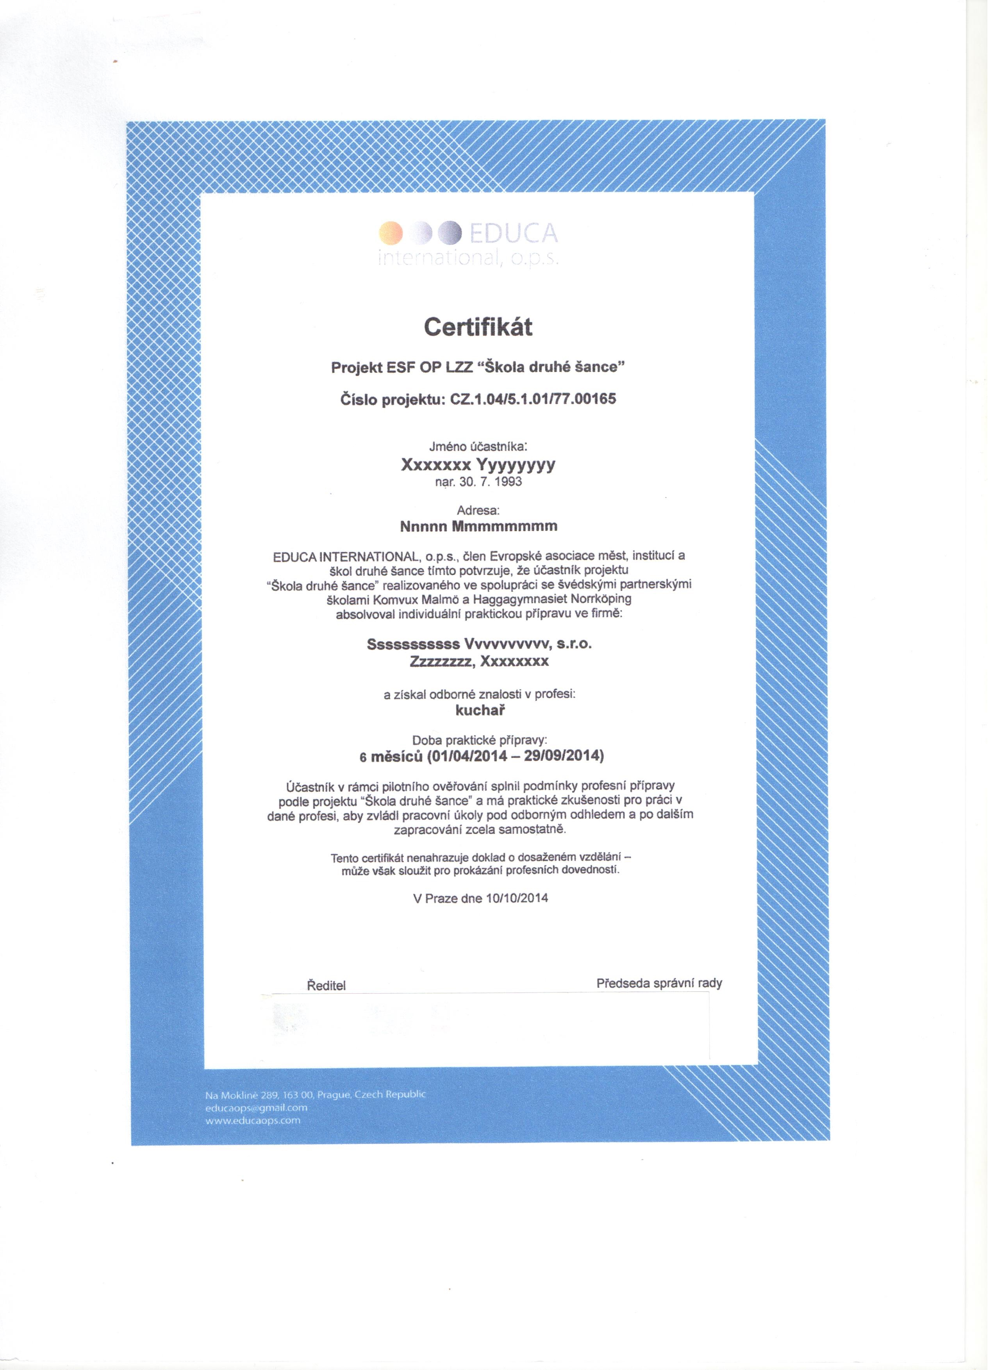
Certifikate

Slide 14
Achieved results
Most of our students get a job after they have finished Second Chance School – in average more than 70%

Slide 15
GOOD PRACTICE
Unconventional solutions
Different methodology
Safe environment - positive dynamics
Gradually increasing difficulty
Cooperation with enterprises
Improvement of social skills

Slide 16
Steps out …
….to the labour market with experience and practical training!
being prepared for the adult working life
having a network of help and a social network
having gained self-confidence, self-esteem
having improved their social competences

Slide 17
Manual for SCS Tutors
OUR BASIC TRAINING MATERIAL is based on:
feedback from our tutors and mentors
the experience of teachers from Kladno-Vrapice, teachers from Sweden and other mentors we cooperate with
feedback from our students
the communication with special pedagogues
cooperation with psychologists
observation
feedback from the E2C meetings (European Association of Cities for Second Chance Schools)

Slide 18
Meeting with young drop-outs
In November 2016 it was proposed to present SLADENO project to the director of Labour Market Office in Kladno
14th of December 2016, the LMO arranged a workshop with a group of drop-outs registered with unemployed status
12 young drop-outs had been invited and 9 of them took part
Representatives of Educa presented the project SLADENO
2 students of vocational school Kladno-Vrapice presented their school and their own experience with it

Slide 19
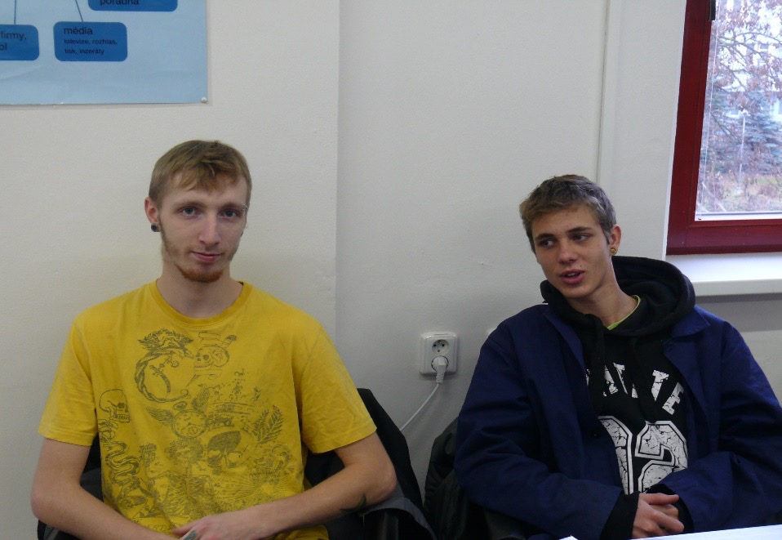
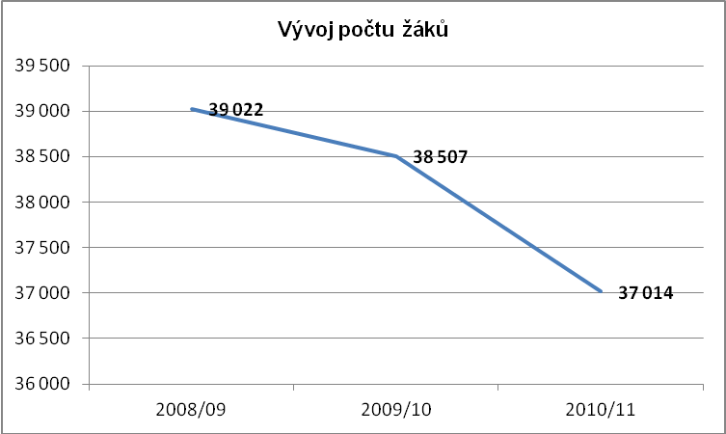
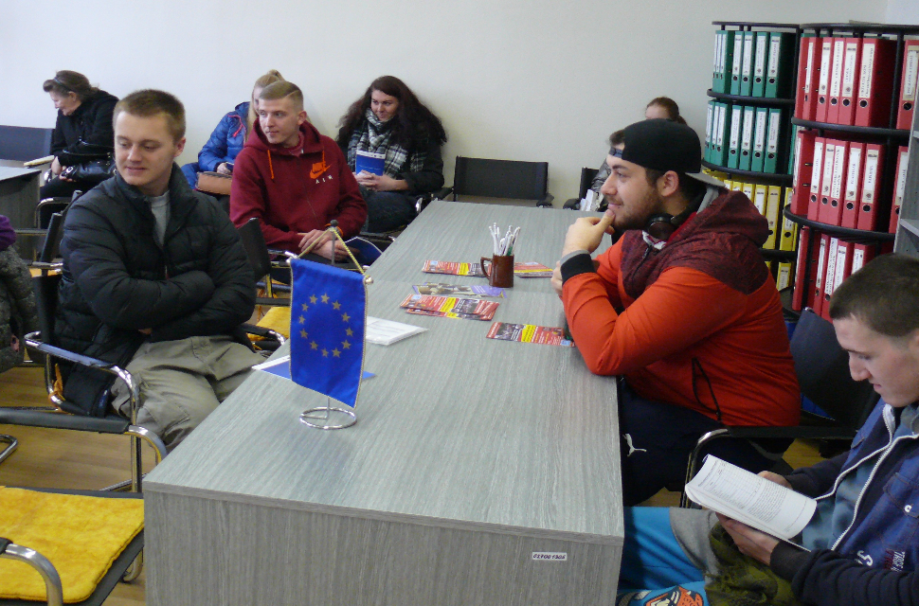
Meeting with drop-outs
December 2016
students presenting their
school
Young people without qualification and without a job

Slide 20
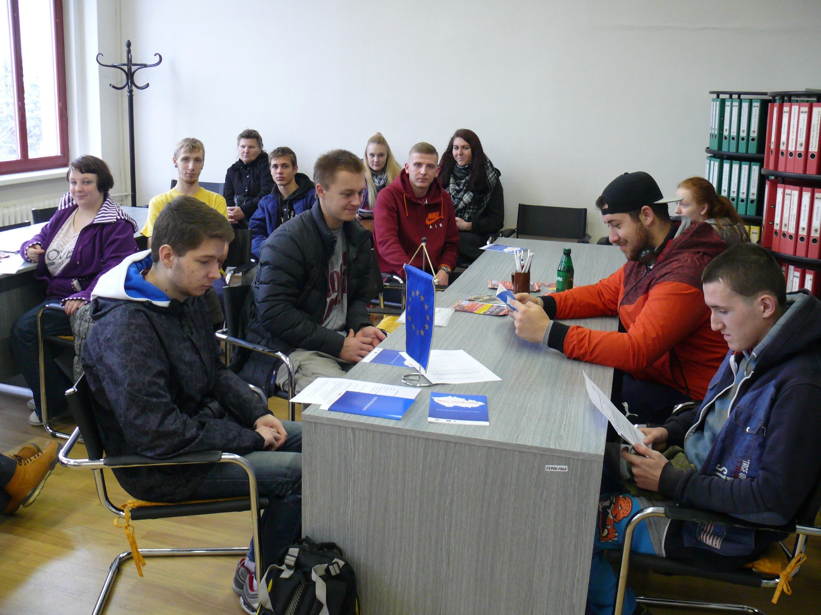

Slide 21
Progress of the meeting
Participants were informed how they can start the training of the Second Chance School
Students from Vrapice promised to help the drop-outs out and informed them that can either attend the Vrapice vocational school (including the theoretical lessons) or attend the Second Chance School training (which means purely attending the practice)
Participants received the application form for the Second Chance School • the 1st training activities started on February 2017
by now four SCS students have already successfully completed the training

Slide 22
Summary of so far realised dissemination activities
Educa has presented project activities on the meeting of schools active in Erasmus projects – 70 participants in Brno (October 2016)
Meeting of vocational schools, presentation of the project – 60 participants (November 2016, Prague)
Educa obtained an award for the highest quality Erasmus project (Placements for Graduates) and this opportunity served to present of the current running projects including SLADENO – 100 participants (school, universities, adult education institutions)
Article in the newspaper Kladenský deník about the school activity and how the SLADENO project is realised
Meeting with representatives of Ministry od Education

Slide 23
Thank you for your attention
Vladimira Rehackova
EDUCA INTERNATIONAL, o.p.s.
Na Moklině 16, 163 00 Praha 6, CZ
E-mail: educaops@gmail.com
www.educaops.eu
tel.: +420 702 062 044

